Slide 1
IETF Hackathon
IETF 113
19 – 20 March 2022
Vienna

Slide 2
Welcome back!
First in-person event since COVID-19?

Slide 3
Welcome back!
First in-person event since COVID-19?
First IETF Hackathon?

Slide 4
Welcome back!
First in-person event since COVID-19?
First IETF Hackathon?
First IETF event?

Slide 5
Why Are We Here
Advance pace and relevance of IETF standards
Bring speed and collaborative spirit of open source community into IETF
Flush out ideas, feed into working group sessions
Produce sample code, reference implementations, utilities
Attract developers, new people to IETF
Match new, skillful developers with IETF veterans
University engagement

Slide 6
Note Well
This is a reminder of IETF policies in effect on various topics such as patents or code of conduct. It is only meant to point you in the right direction. Exceptions may apply. The IETF's patent policy and the definition of an IETF "contribution" and "participation" are set forth in BCP 79; please read it carefully.
As a reminder:
By participating in the IETF, you agree to follow IETF processes and policies.
If you are aware that any IETF contribution is covered by patents or patent applications that are owned or controlled by you or your sponsor, you must disclose that fact, or not participate in the discussion.
As a participant in or attendee to any IETF activity you acknowledge that written, audio, video, and photographic records of meetings may be made public.
Personal information that you provide to IETF will be handled in accordance with the IETF Privacy Statement.
As a participant or attendee, you agree to work respectfully with other participants; please contact the ombudsteam (https://www.ietf.org/contact/ombudsteam/) if you have questions or concerns about this.
Definitive information is in the documents listed below and other IETF BCPs. For advice, please talk to WG chairs or ADs:
BCP 9 (Internet Standards Process)
BCP 25 (Working Group processes)
BCP 25 (Anti-Harassment Procedures)
BCP 54 (Code of Conduct)
BCP 78 (Copyright)
BCP 79 (Patents, Participation)
https://www.ietf.org/privacy-policy/ (Privacy Policy)

Slide 7
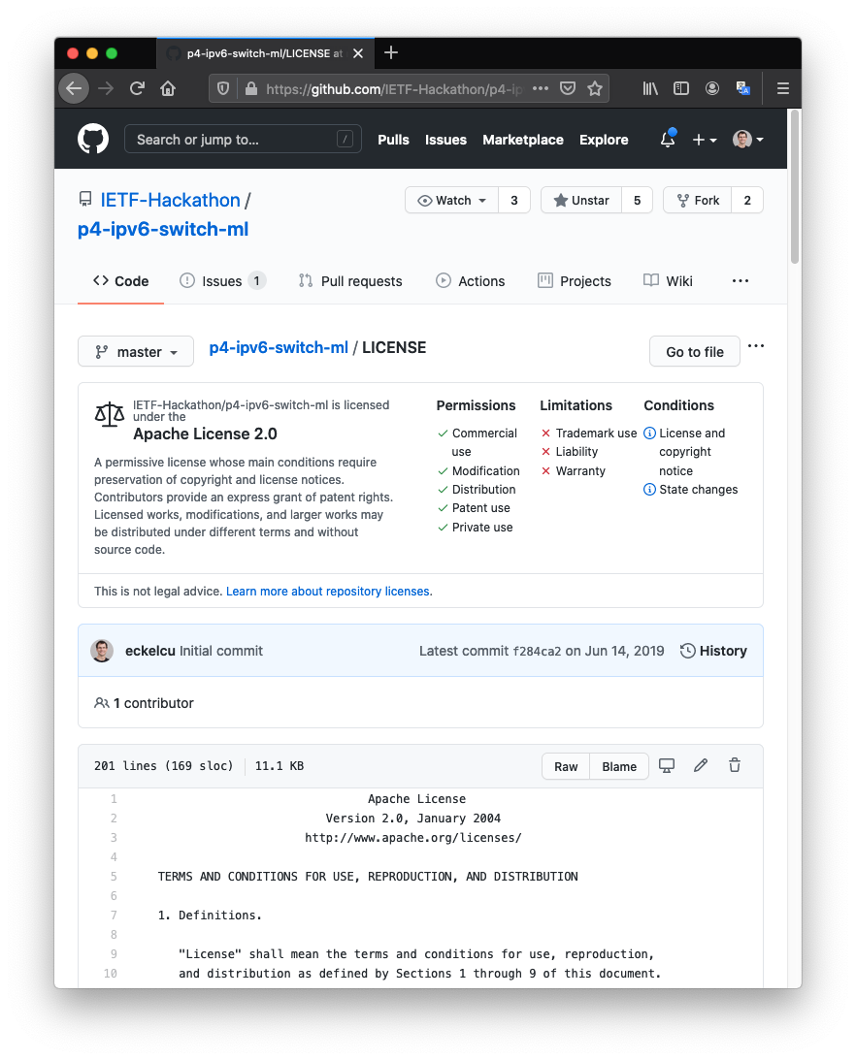
IPR and Code Contribution Guidelines
Participants can work on any code
Rules regarding code are per participant's organization and the code’s license
The code itself is NOT an IETF contribution
Discussions, presentations, and demos in Hackathon are IETF contributions. In this context, Hackathon is like a working group, and the usual IETF copyright and IPR disclosure rules apply

Slide 8
Inclusive Language
Contributions to the IETF, including Internet-Drafts and RFCs, are most understandable and effective when they use terminology that is clear, precise, and widely accessible to readers from varying backgrounds and cultures.
The IESG hence encourages IETF participants to use the guidance in [NISTIR8366] when making contributions to the IETF. Although developed for use within the US National Institute of Standards and Technology (NIST), the IETF community expressed strong support for the sentiment that the guidance on inclusive language in [NISTIR8366] is suitable for the IETF as well [1,2]. Using the same terminology as other standards organizations and industry initiatives also contributes to overall coherence in the industry.
https://www.ietf.org/about/groups/iesg/statements/on-inclusive-language/

Slide 9
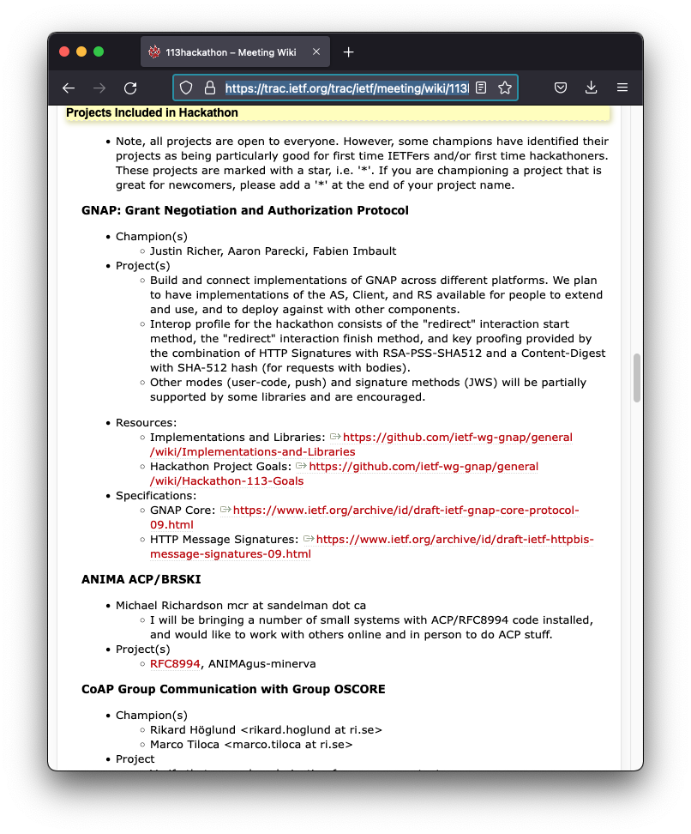
Projects
On the Hackathon wiki
Not sure which project to join?

Slide 10
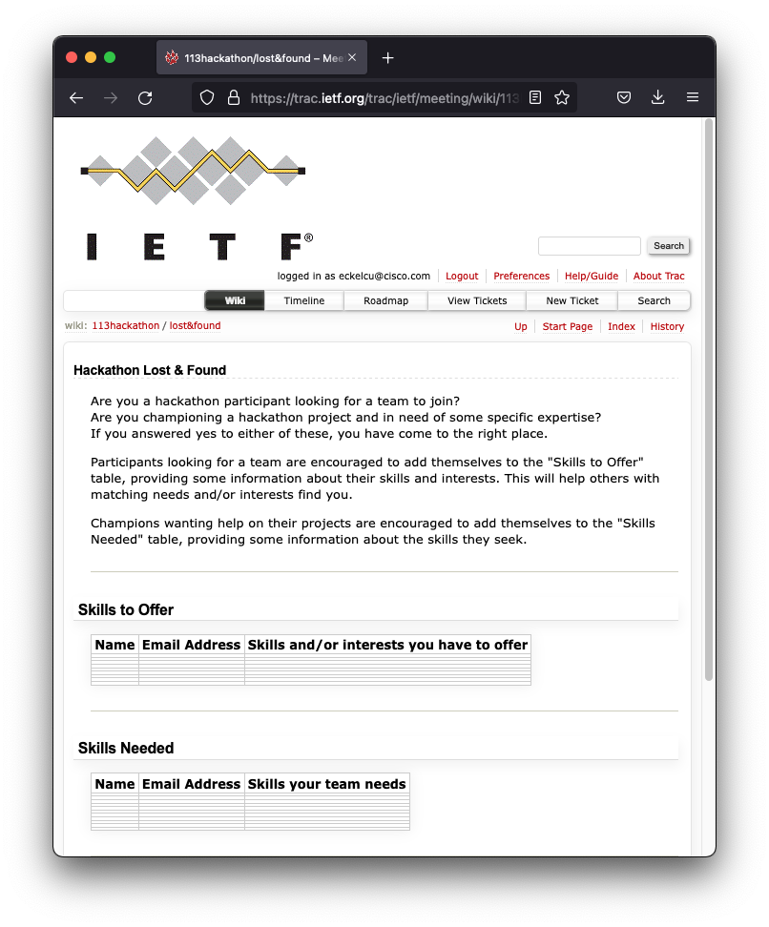
Projects
On the Hackathon wiki
Not sure which project to join?
Check the Lost & Found

Slide 11
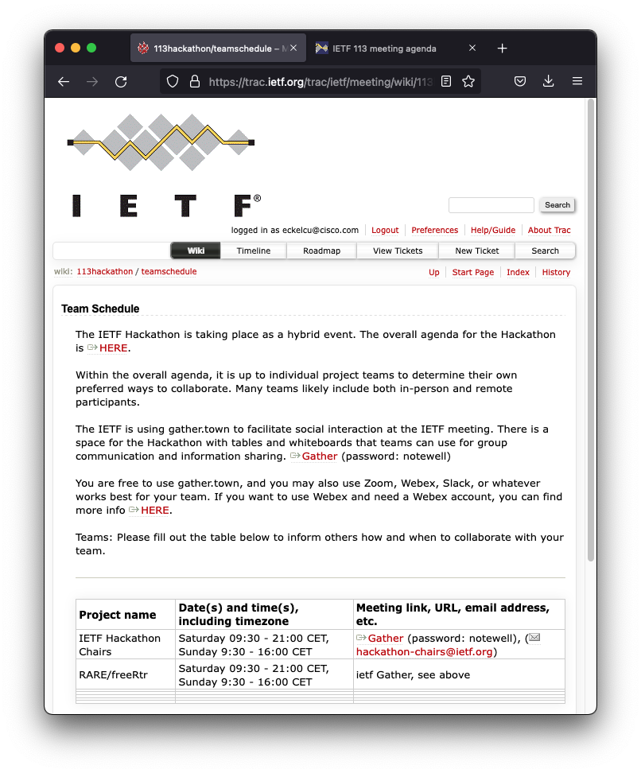
Agenda - Saturday
09:30: Room open for setup by project champions
10:00: Room open for all - Pastries and coffee provided
10:30: Hackathon kickoff, Meetecho
10:45: Form Teams, see ​Team Schedule
12:30: Lunch provided
15:30: Afternoon break - Snacks provided
18:30: Dinner provided
21:00: Room closes

Slide 12
Agenda - Sunday
09:30: Room opens - Pastries and coffee provided
12:30: Lunch provided
13:30: Hacking stops, prepare brief presentation of project
14:00: Project Results Presentations, see ​schedule, ​Meetecho
16:00: Hackathon ends
17:00: Tear down complete

Slide 13
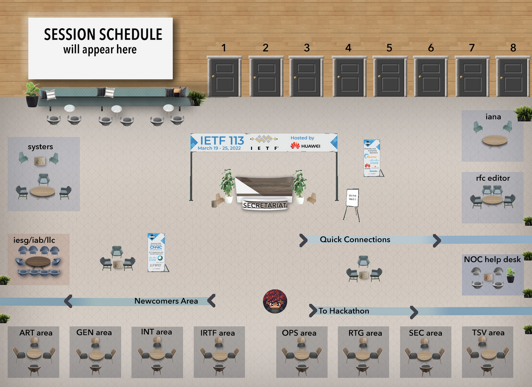
Gather https://gather.town/app/L4fNNdm1NJa1sE2v/ietf

Slide 14
Gather https://gather.town/app/L4fNNdm1NJa1sE2v/ietf

Slide 15
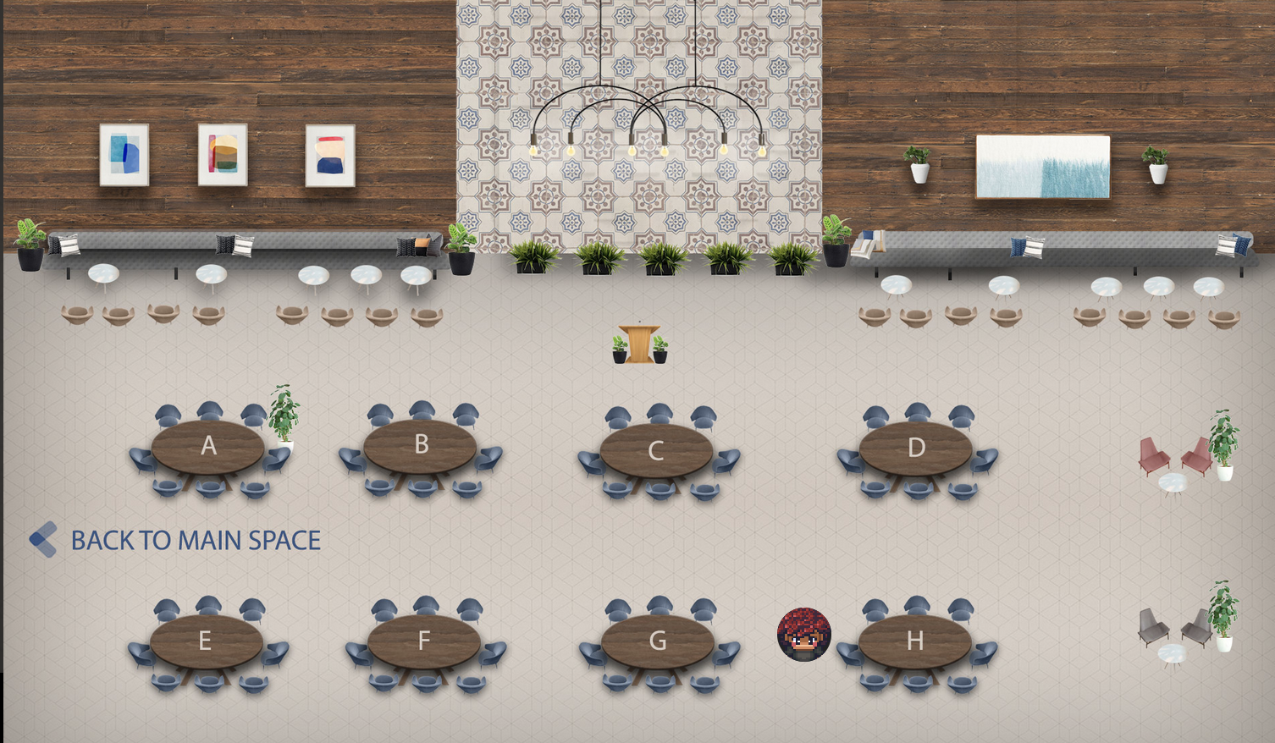
Hackathon Space

Slide 16
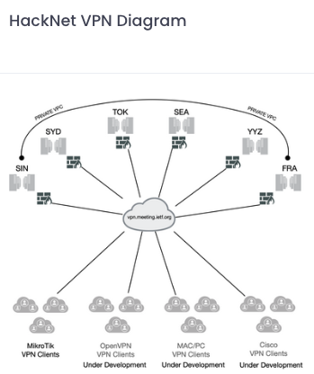
HackNet (https://hacknet.meeting.ietf.org)
The NOC team experiment allows you to join the IETF network while attending remotely
Version 2 is a complete rebuild of the network
Auto provisioning of credentials and device configuration
MikroTik is the only hardware that is supported
More device types to be added
Legacy Pi network is still active but will not have future development or support

Slide 17
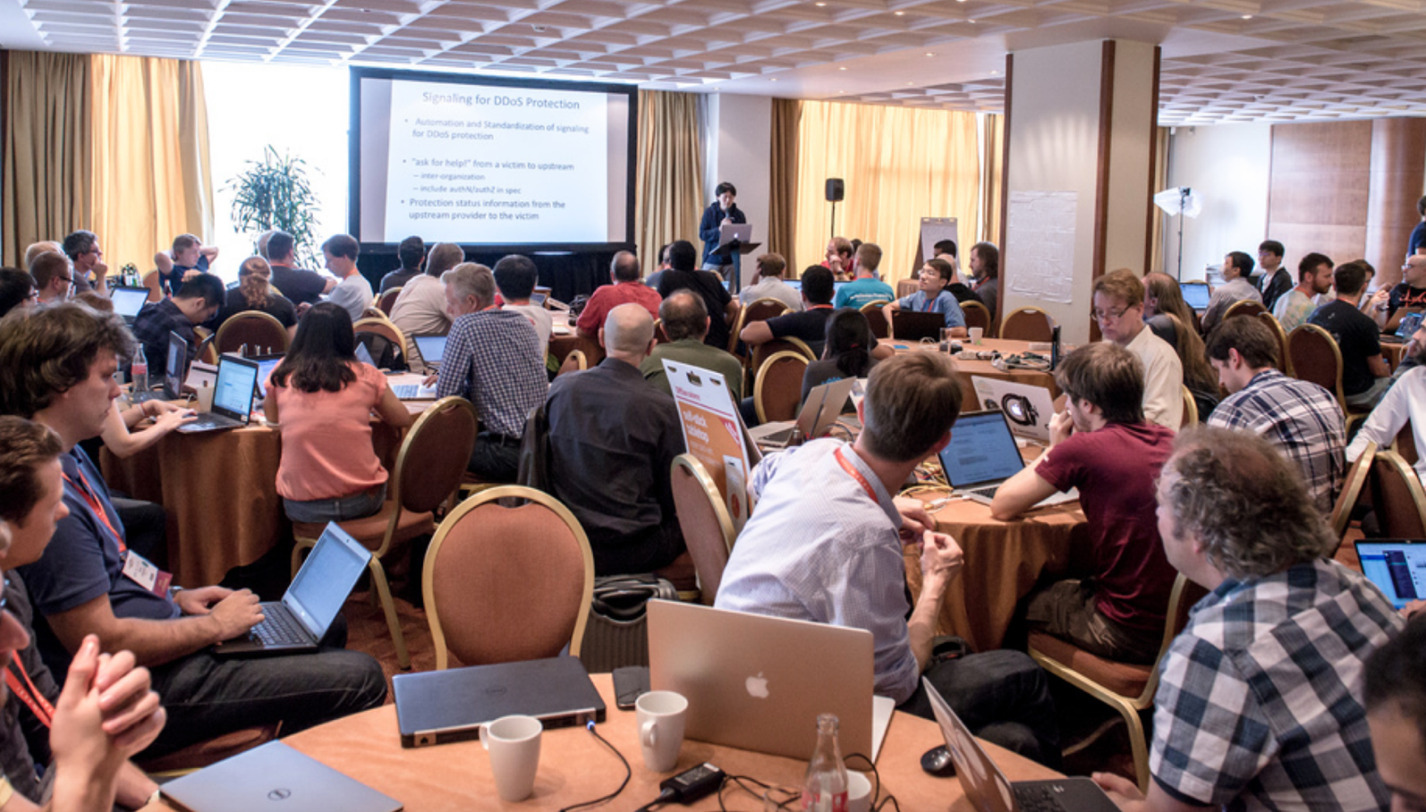
Results Presentations
What problem you tried to solve?
What you achieved?
Highlights
Lessons learned
Feedback to working group
Open source, other SDOs
5 minutes max

Slide 18
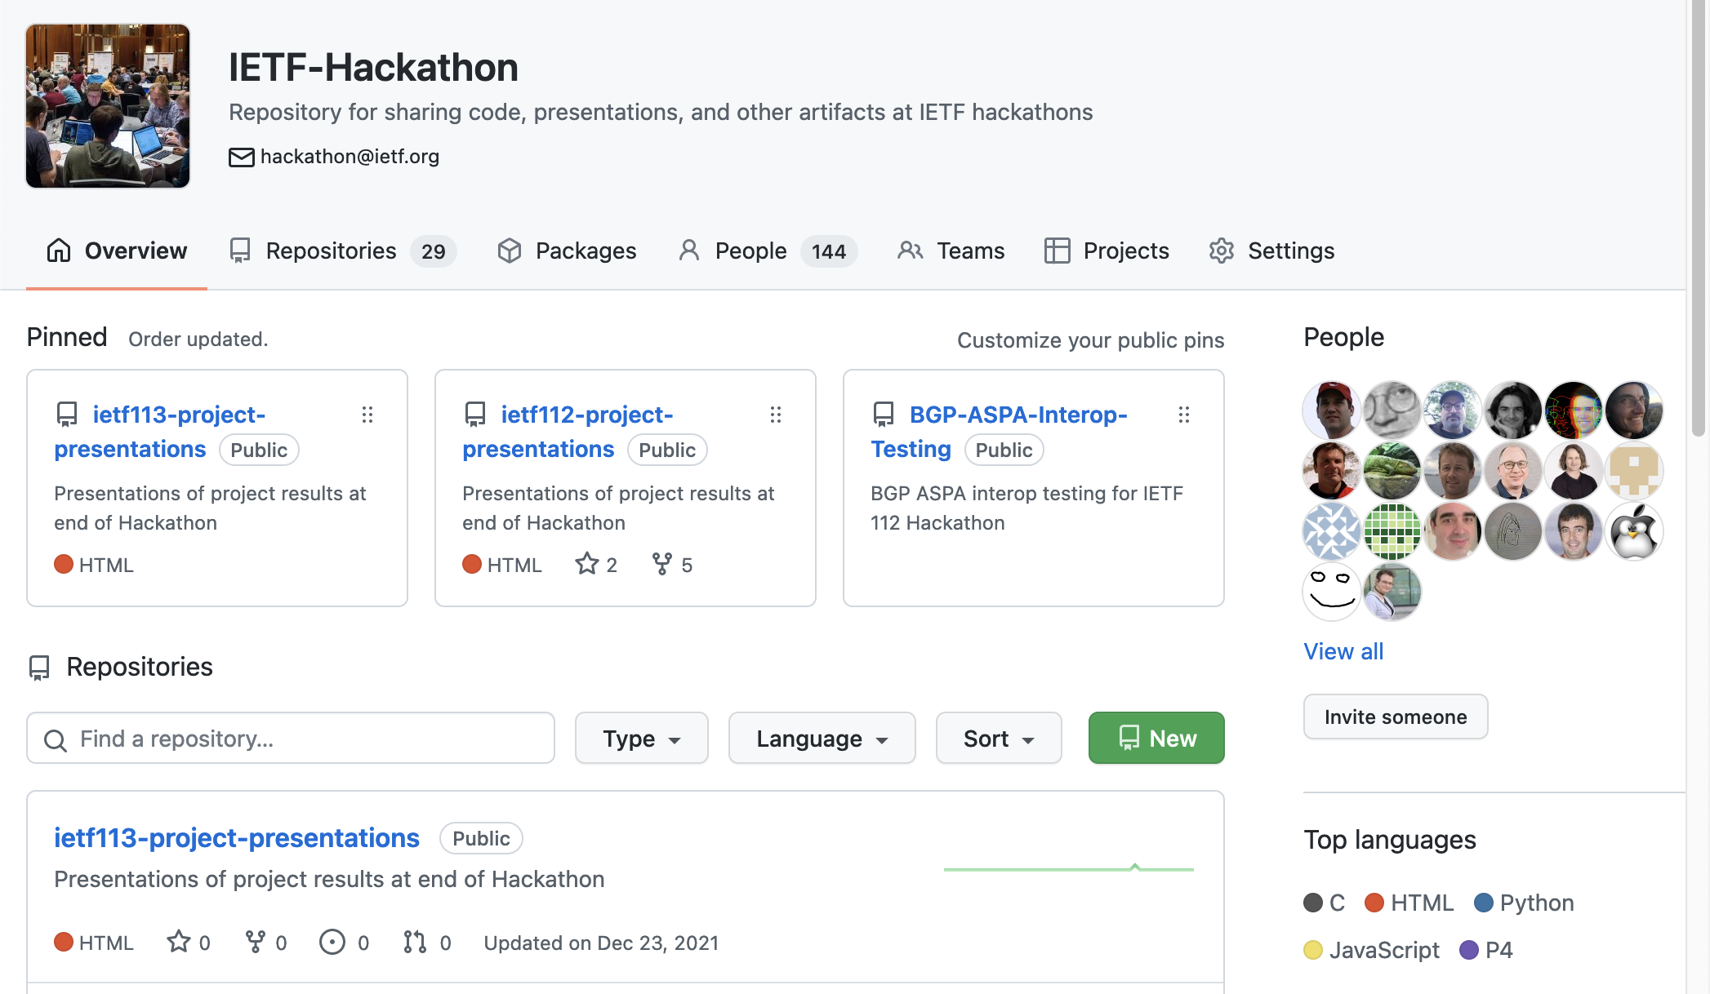
https://github.com/ietf-hackathon

Slide 19
https://github.com/ietf-hackathon

Slide 20
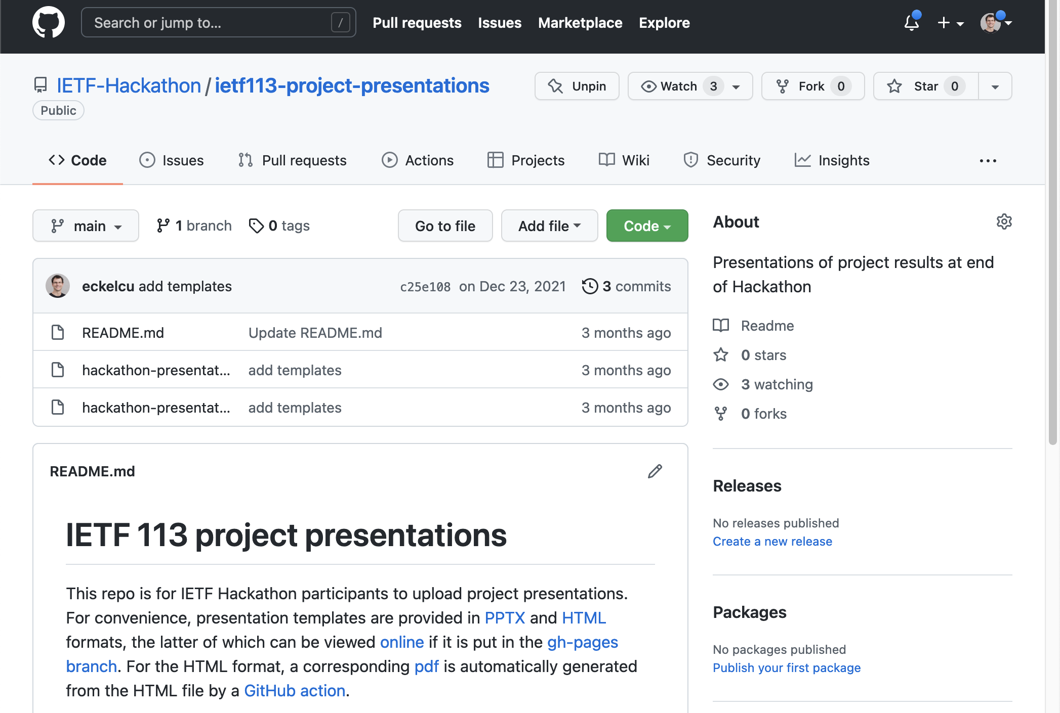
https://github.com/IETF-Hackathon/ietf113-project-presentations

Slide 21
https://github.com/IETF-Hackathon/ietf113-project-presentations

Slide 22
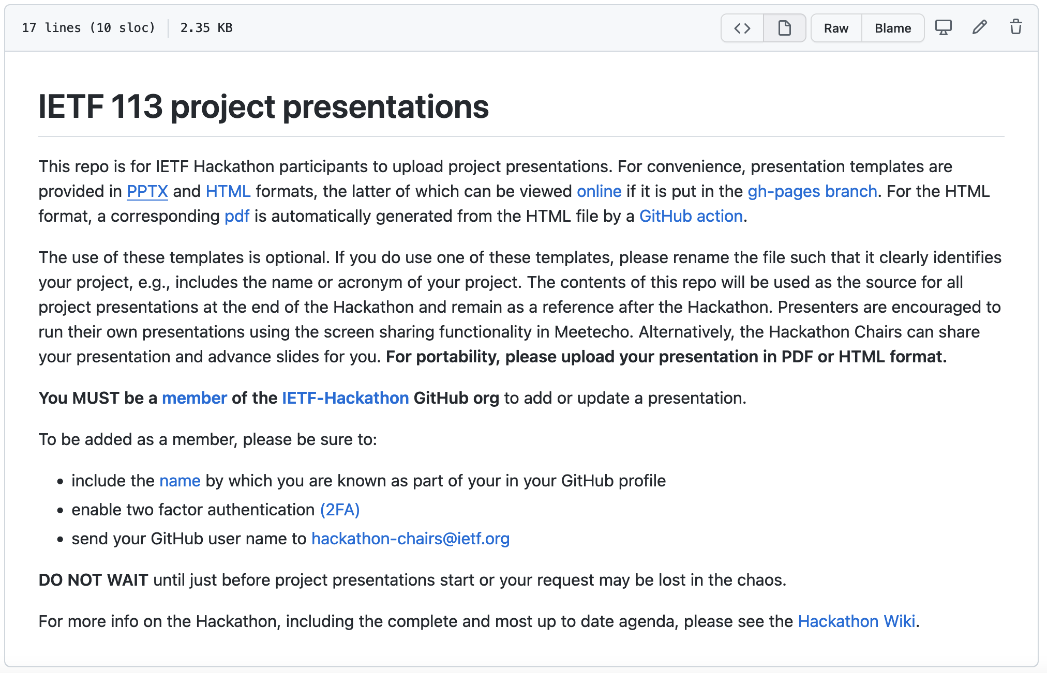
README

Slide 23
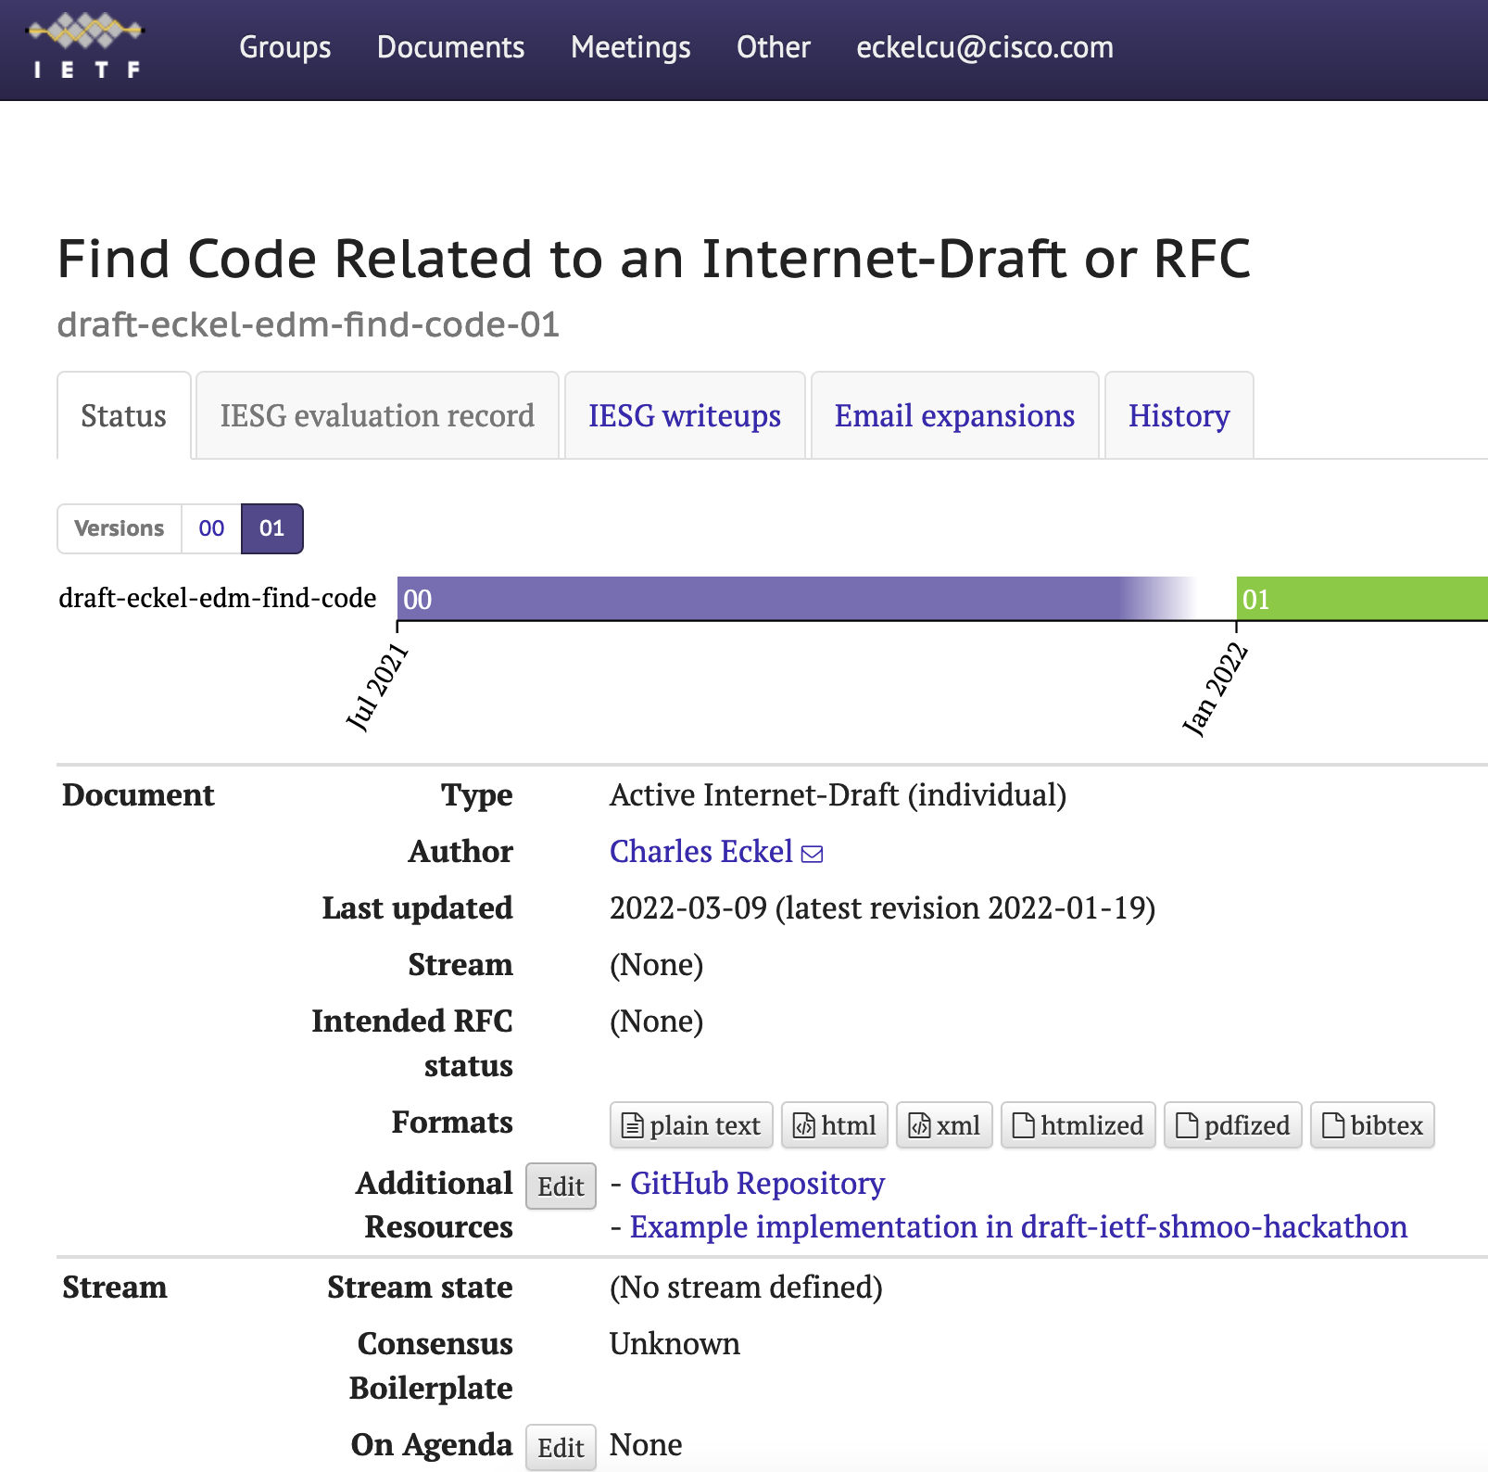
Related-implementations
For individual drafts, authors can edit the set of “Additional resources”
For WG drafts and RFCs, the chairs can edit the additional resources

Slide 24
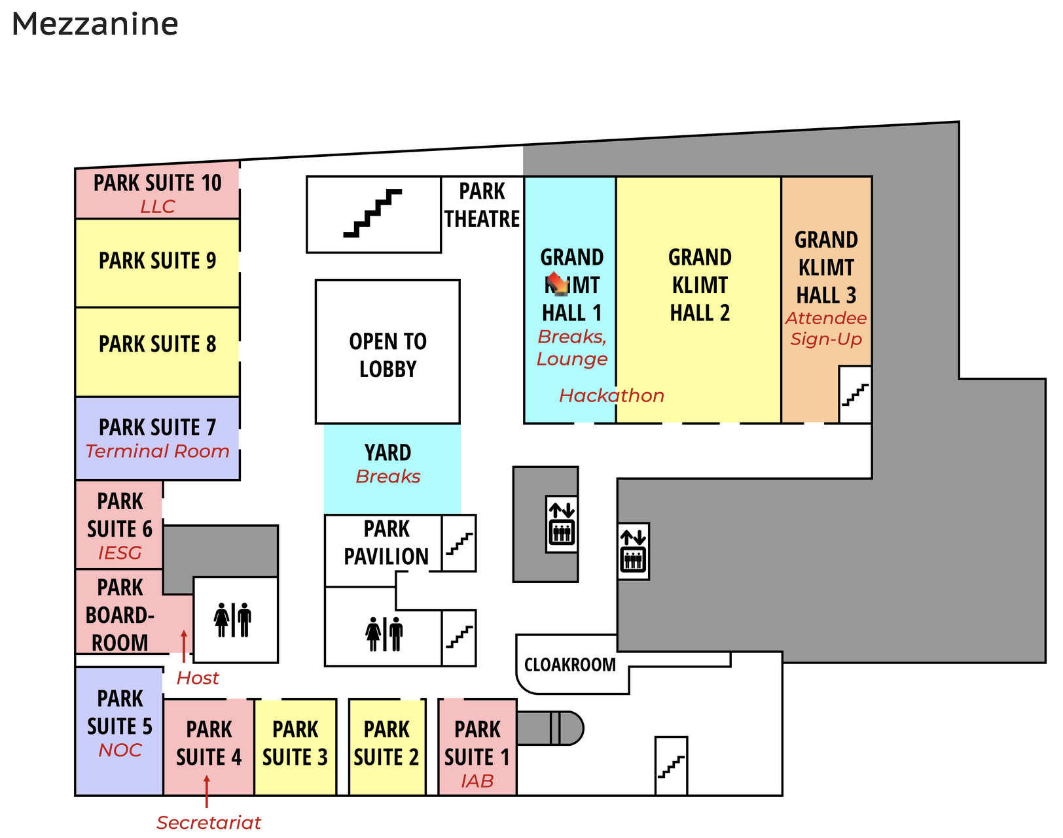
Hackdemo Happy Hour
Share hackathon projects with IETF Community
Grand Klimt Hall 1
Monday 17:00 - 18:30
Register your team
MUST REGISTER BY 12:00 MONDAY

Slide 25
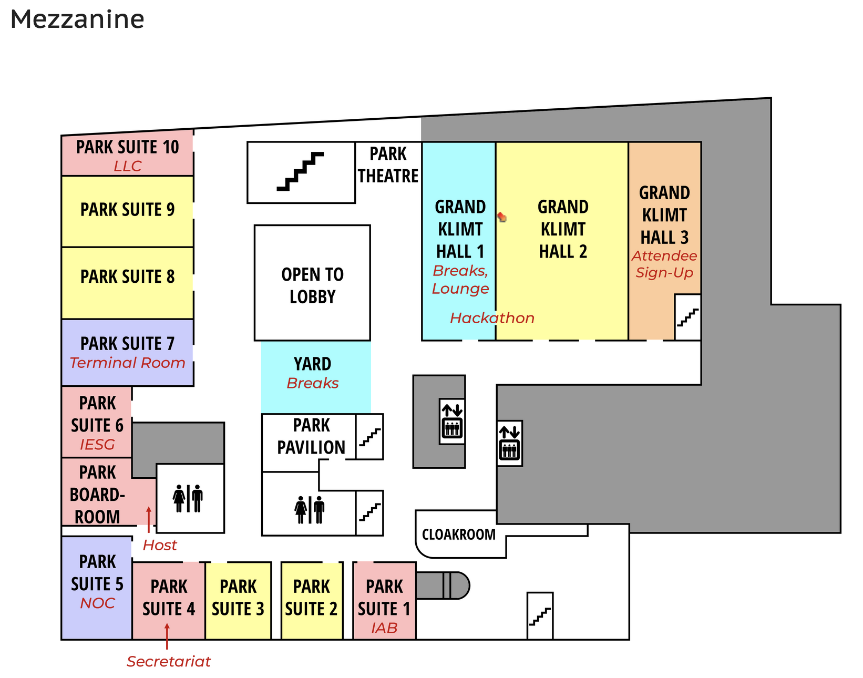
Code Lounge
Grand Klimt Hall 1/2
Space reserved in IETF lounge all week
Collaborate on running code
Schedule time for your team

Slide 26

THANK YOU!

Slide 27

Questions?

Slide 28
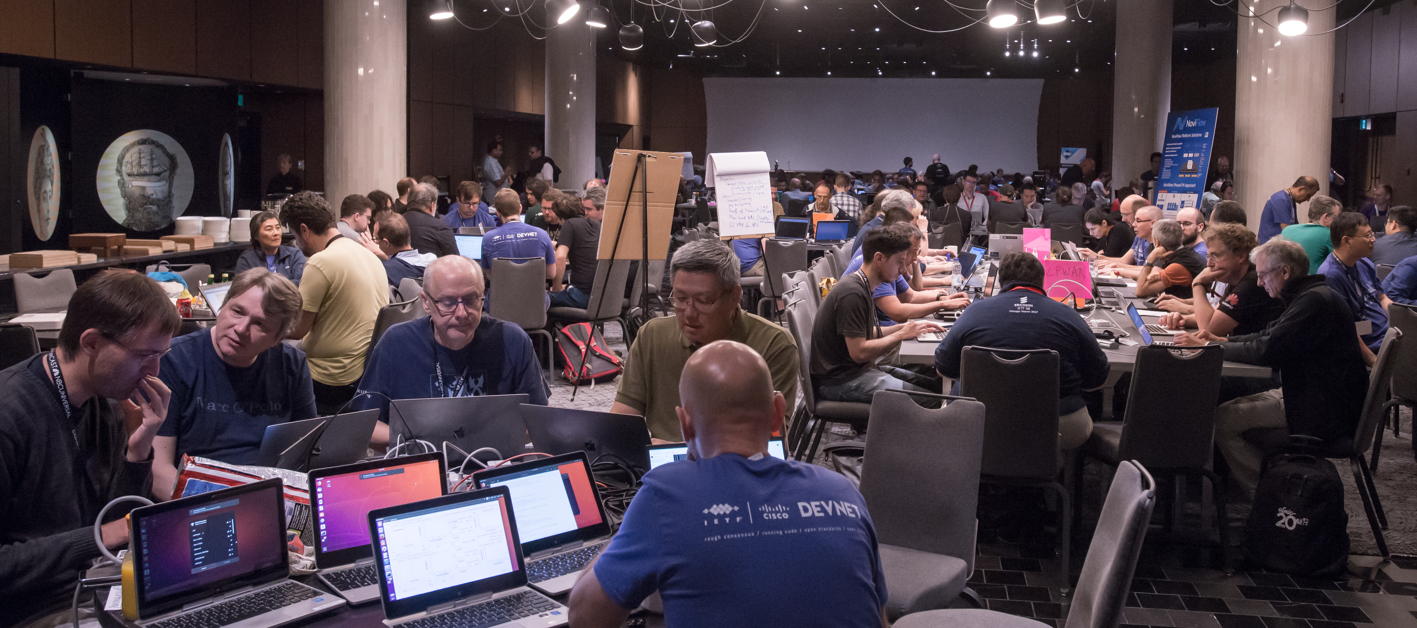
Let’s Start Coding!

